Slide 1

Topic: Letter format & Letter Writing Sir, Muhammad Zaman Hashmi

Slide 2
What is Letter?
A letter is a written message sent by one person to another. In other words, a letter is a piece of conversation by post.
So, when we transfer any written message through mail, it can be termed as letter.
According to Oxford Dictionary,
“A letter is a message that is written down or printed on paper and usually put in an envelope and sent to somebody.”

Slide 3
Types of Letter Writing
Types of letter writing are broadly classified into two types: formal letter writing and informal letter writing.
What is Formal Letter Writing?
Formal letter writing is used to write letters to business houses, customers, government officials, school/college authorities, editors, colleagues, strangers and acquaintances.
What is Informal Letter Writing?
Informal letter writing is used to write letters to relatives and friends.
Since such letters are personal in nature.
They should be written in a simple, clear, easy to understand, natural and lively style just as one talks to a friend/relative

Slide 4
Types of Informal and Formal Letter Writing
Personal Letter
Letter inquiring about the health
Letter of invitation
Letter to congratulate:
Letter to seek help
Letter sent along with a personalized gift
Letter written to apologize for a mistake
Letter written to plan a weekend or vacation with friends
Letter to inform about the sudden demise of someone
Business Letter
Official Letter
Social Letter
Report Letter
Notice Letter
Circular Letter
Order Letter
Complaint Letter
Employment Letter

Slide 5
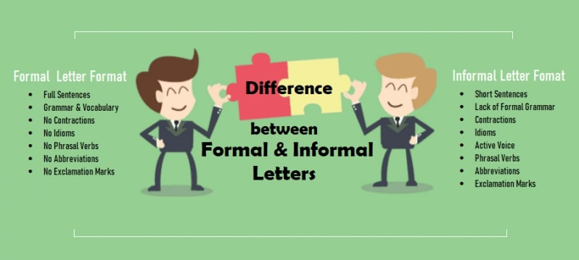
Remember it

Slide 6
Proper Letter Format:
1. Sender’s Information
It’s important to know how to address a business letter properly, especially if you’re expecting a reply.
What to include and formatting:
Name
Street Address
City, State,
Country (if not in the same country as your recipient)
Your Phone Number
Your Email
Note: Leave an empty line and write the date just below the sender’s address

Slide 7
2. Today’s Date
Spell out the month and include the complete year. Write the month, date, and year
Example: March 11, 2022
Note: Leave another empty line and write the recipient’s title, name, position and address
3. Addressee Information (Inside Address)
Include the recipient’s information, starting with their name, followed by their job title and complete address. Address the recipient using Ms., Mr., or use any job-appropriate title as necessary
Name
Job Title
Company Street Address
City, State, Zip Code
Country (optional)

Slide 8
4. Salutation
Start the letter with the right salutation, depending on whether you know the recipient and how well you know them.
In American English, we use a colon after salutations in formal business letters.
In British English, we use a comma. Here are some examples:
Dear Ms. Smith: (If you know the recipient’s name.)
Dear Jane: (If you know the recipient quite well and call each other by your first names.

Slide 9
5. Body Text
The body of the letter is usually composed of one to three brief paragraphs, each with a specific intent and organized for clarity.
Introduction. Explains the reason for the letter and what you want to achieve with it. If the recipient doesn’t know who you are, you can also mention mutual connections here.
Second paragraph. Gives more detail about your request, such as the steps you’ve taken or fees paid. In case of marketing or job application letters, the second paragraph is where you’ll sell the product you’re promoting or your application.
Third paragraph. Optional and is included in situations where the second paragraph isn’t enough to explain the situation in full.

Slide 10
6. CLOSING
The closing begins at the same vertical point as your date and one line after the last body paragraph.
Capitalize the first word only (for example: Thank you) and leave four lines between the closing and the sender's name for a signature.
If a colon follows the salutation, a comma should follow the closing; otherwise, there is no punctuation after the closing.
Conclude your letter and say your goodbyes. Yours lovingly, Sincerely, Sincerely yours, Regards, Yours truly, and Yours sincerely
Signature: This is the actual signature of the person the letter is from, which may be different from the person who wrote the letter.

Slide 11
Formal Letter Writing Senders address (with pin code) _________________ _________________ _________________ Date: ____________ (Designation of the recipient), (Name of the organization/company), Receiver’s address (with pin code) _________________ _________________ _________________ Sir/Madam, (Salutation) Subject: _____________________________________________. BODY Paragraph 1: ___________________________________ (Give reasons for writing). Paragraph 2: ___________________________________ (Explain the details, facts and figures and do not use short forms.) Paragraph 3: ______________________________. I look forward to hearing from you soon. (Concluding remarks/ suggestions/ asking help) Yours sincerely, (Closing salutation) Your name and signature

Slide 12
A sample format for informal letter writing is given below:
Sender’s Name & Address
__________________
__________________
__________________
Date _____________
Dear__________ (Name of the recipient), (Salutation)
BODY
Paragraph 1: I hope my letter finds you in good health. ____________________________.
Write about the purpose of writing. You can use an informal tone.)
Paragraph 2: _____________________________________.
(Write in detail about the purpose.)
Paragraph 3: _____________________________________.
(Concluding lines)
Yours affectionately, (Complimentary closing)
Your name.

Slide 13
Thank You for Patiently Listening!

